Slide 1
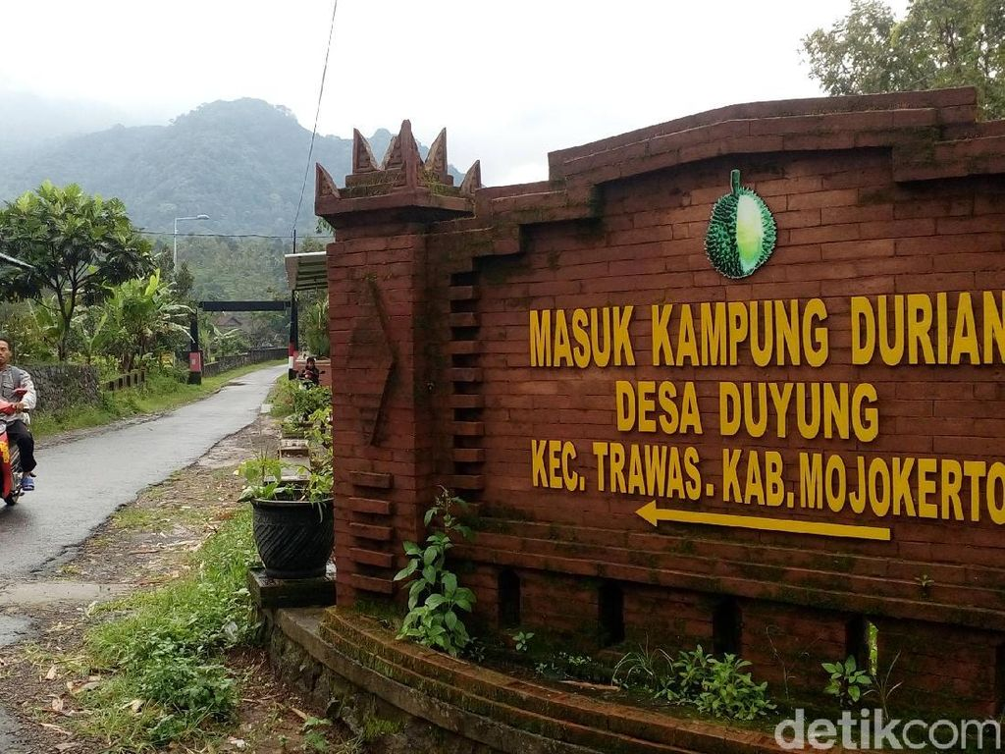
a
Supported by:
DIES NATALIS KE-59
Universitas Negeri Jakarta 1964 - 2023
Menuju universitas kelas dunia
KLJNTKJURNAL
tet�iv
\NEB Or SCIEr--..CE
Reputable Publicatio11
GENERASI PENELITI
I-CALLED
F B S . 2 0 2 3
Powered by:
CONFERENCE SYSTEM J, ,\,,\LH1 c,I
generoslpenellti.ld
International Conference on Culture, Arts, Language, Literature and Education
Faculty of Languages and Arts, Universitas Negeri Jakarta
AKADEMISI
Ad, ftlv1c"1tio� "1�tl C,v1(tv1v�
Cl Virtual via ZOOM
h ttps://icaI led-fbs-u nj. akademisi. co. id/
November 1st - 2nd, 2023
Empowering a village community through training on healthy lifestyle and appropriate medicine-related behavior
Sylvi Irawati^{1,2}, Aguslina Kirtishanti¹, Vendra Setiawan¹, Astridani Risky Putranti¹, Reine Risa Risthanti¹, Finna Setiawan¹, Nikmatul Ikhrom Ekajayani¹
¹ Departemen Farmasi Klinis dan Komunitas, Fakultas Farmasi, Universitas Surabaya, Surabaya, Jawa Timur, 60293 Indonesia, syl@staff.ubaya.ac.id
² Pusat Informasi Obat dan Layanan Kefarmasian (PIOLK), Fakultas Farmasi, Universitas Surabaya, Surabaya, Jawa Timur, 60293 Indonesia
Acknowledgement:
DRTPM Kemdikbudristek
Pemerintah Desa Duyung, Trawas, Mojokerto
Universitas Surabaya
Universitas Katolik Widya Mandala

Slide 2
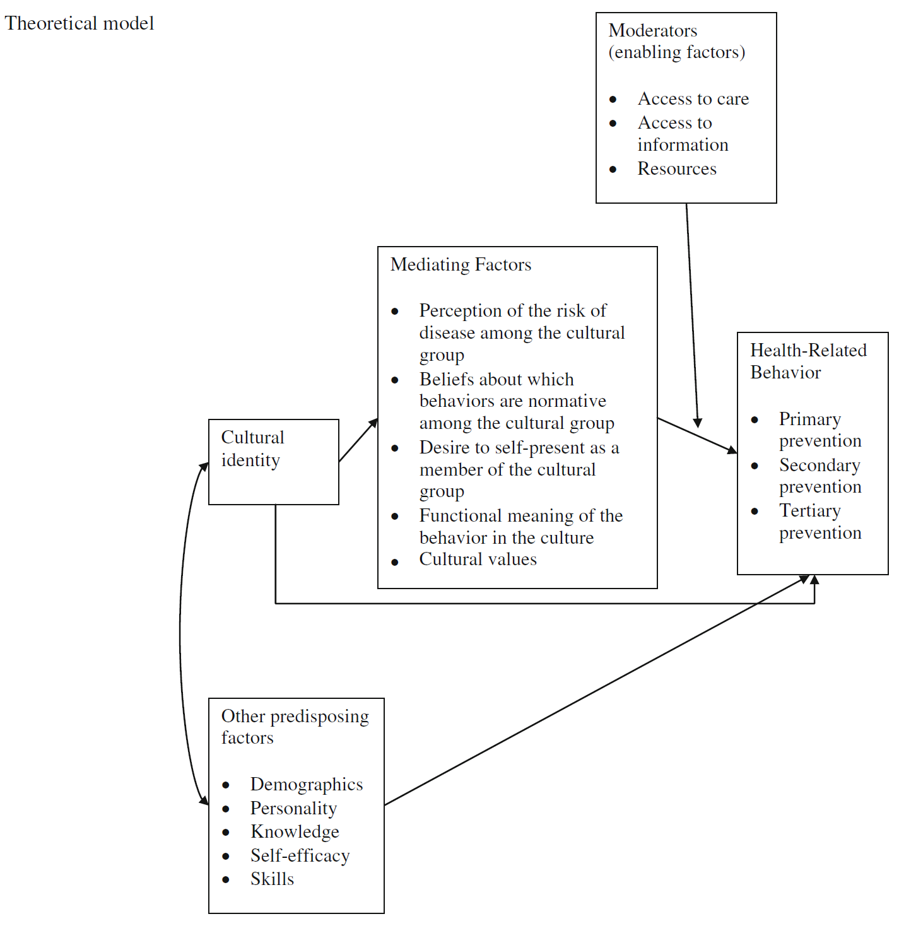
a
Supported by:
DIES NATALIS KE-59
Universitas Negeri Jakarta 1964 - 2023
Menuju universitas kelas dunia
KLJNTKJURNAL
tet�iv
\NEB Or SCIEr--..CE
Reputable Publicatio11
GENERASI PENELITI
I-CALLED
F B S . 2 0 2 3
Powered by:
CONFERENCE SYSTEM J, ,\,,\LH1 c,I
generoslpenellti.ld
International Conference on Culture, Arts, Language, Literature and Education
Faculty of Languages and Arts, Universitas Negeri Jakarta
AKADEMISI
Ad, ftlv1c"1tio� "1�tl C,v1(tv1v�
Cl Virtual via ZOOM
h ttps://icaI led-fbs-u nj. akademisi. co. id/
November 1st - 2nd, 2023
Theoretical Model
Cultural identity is an identity claimed by an individual as a member of a cultural group with shared characteristics.
Cultural identity may indirectly influence health-related behaviour, including on how a person within the culture acts to prevent and treat a disease.
One example of how cultural identity may determine health-related behaviours is shown by the difference in medical decision-making process among cultural groups.
Unger, JB. (2011). Cultural Identity and Public Health. In: Schwartz, S., Luyckx, K., Vignoles, V. (eds). Handbook of Identity Theory and Research. Springer, New York, NY.
BACKGROUND

Slide 3
a
Supported by:
DIES NATALIS KE-59
Universitas Negeri Jakarta 1964 - 2023
Menuju universitas kelas dunia
KLJNTKJURNAL
tet�iv
\NEB Or SCIEr--..CE
Reputable Publicatio11
GENERASI PENELITI
I-CALLED
F B S . 2 0 2 3
Powered by:
CONFERENCE SYSTEM J, ,\,,\LH1 c,I
generoslpenellti.ld
International Conference on Culture, Arts, Language, Literature and Education
Faculty of Languages and Arts, Universitas Negeri Jakarta
AKADEMISI
Ad, ftlv1c"1tio� "1�tl C,v1(tv1v�
Cl Virtual via ZOOM
h ttps://icaI led-fbs-u nj. akademisi. co. id/
November 1st - 2nd, 2023
In countries with low scores on power distance and collectivism, such as Western countries, medical decision-making is perceived as a basic personal right.
Healthcare professionals inform the patient on their condition and the treatment options, and the patient finally decides which option they want to take.
In countries with high scores on power distance and collectivism/communal culture, such as Latin American and Asian, including Indonesia, medical decision-making is viewed as a community or family activity.
The patient follows the instructions from their physicians; Neighbours or family members help the patient to decide the treatment option
It is common that rural or village residents have shown more collectivist or communal culture than urban or city residents
Knowledge, self-efficacy, and skills are factors related to cultural identity and health-related behaviour
BACKGROUND

Slide 4
a
Supported by:
DIES NATALIS KE-59
Universitas Negeri Jakarta 1964 - 2023
Menuju universitas kelas dunia
KLJNTKJURNAL
tet�iv
\NEB Or SCIEr--..CE
Reputable Publicatio11
GENERASI PENELITI
I-CALLED
F B S . 2 0 2 3
Powered by:
CONFERENCE SYSTEM J, ,\,,\LH1 c,I
generoslpenellti.ld
International Conference on Culture, Arts, Language, Literature and Education
Faculty of Languages and Arts, Universitas Negeri Jakarta
AKADEMISI
Ad, ftlv1c"1tio� "1�tl C,v1(tv1v�
Cl Virtual via ZOOM
h ttps://icaI led-fbs-u nj. akademisi. co. id/
November 1st - 2nd, 2023
The Village of Duyung is located in the District of Trawas, the Regency of Mojokerto, the Province of East Java.
The residents often first seek for medications to the grocery stores (termed as ‘toko kelontong’ or ‘peracangan’) located closer in the village.
The medicines provided by the stores have often been taken out from their primary packages and been put together in a new package without labels.
The residents buy the medicines based on information from their neighbors
This may lead to the use of inappropriate medication for their illness.
BACKGROUND

Slide 5
a
Supported by:
DIES NATALIS KE-59
Universitas Negeri Jakarta 1964 - 2023
Menuju universitas kelas dunia
KLJNTKJURNAL
tet�iv
\NEB Or SCIEr--..CE
Reputable Publicatio11
GENERASI PENELITI
I-CALLED
F B S . 2 0 2 3
Powered by:
CONFERENCE SYSTEM J, ,\,,\LH1 c,I
generoslpenellti.ld
International Conference on Culture, Arts, Language, Literature and Education
Faculty of Languages and Arts, Universitas Negeri Jakarta
AKADEMISI
Ad, ftlv1c"1tio� "1�tl C,v1(tv1v�
Cl Virtual via ZOOM
h ttps://icaI led-fbs-u nj. akademisi. co. id/
November 1st - 2nd, 2023
We designed a training program to increase the knowledge of the Village of Duyung residents on healthy lifestyle and on how to obtain, use, store, and discard medicines.
The aim of the report is to describe awareness of the principles of a healthy lifestyle, appropriate medicine-related behavior, and the impact of including local language in education/training on knowledge changes in the Village of Duyung.
OBJECTIVES

Slide 6
a
Supported by:
DIES NATALIS KE-59
Universitas Negeri Jakarta 1964 - 2023
Menuju universitas kelas dunia
KLJNTKJURNAL
tet�iv
\NEB Or SCIEr--..CE
Reputable Publicatio11
GENERASI PENELITI
I-CALLED
F B S . 2 0 2 3
Powered by:
CONFERENCE SYSTEM J, ,\,,\LH1 c,I
generoslpenellti.ld
International Conference on Culture, Arts, Language, Literature and Education
Faculty of Languages and Arts, Universitas Negeri Jakarta
AKADEMISI
Ad, ftlv1c"1tio� "1�tl C,v1(tv1v�
Cl Virtual via ZOOM
h ttps://icaI led-fbs-u nj. akademisi. co. id/
November 1st - 2nd, 2023
A community empowerment program was designed with an aim to empowering the residents of the Village of Duyung to understand and to apply the principles of healthy lifestyle and the appropriate medicine-related behaviour in everyday life.
Target:
Women involved in the program of family welfare empowerment
(Pemberdayaan Kesejahteraan Keluarga, PKK).
The program consisted of 2 education and training activities:
The principles of healthy life style (Perilaku Hidup Bersih Sehat, PHBS)
The appropriate medicine-related behavior (DaGuSiBu).
A local language (Javanese) were spoken alternately with national language in the program.
METHODS

Slide 7
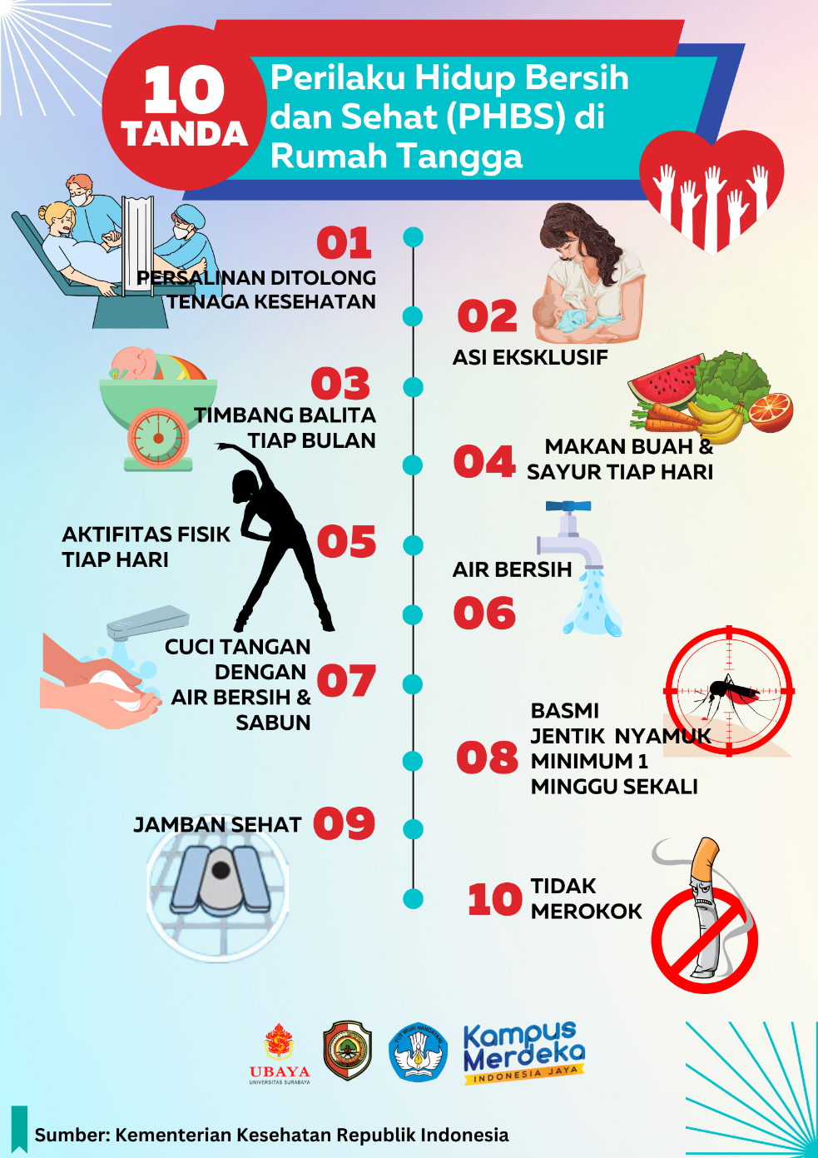
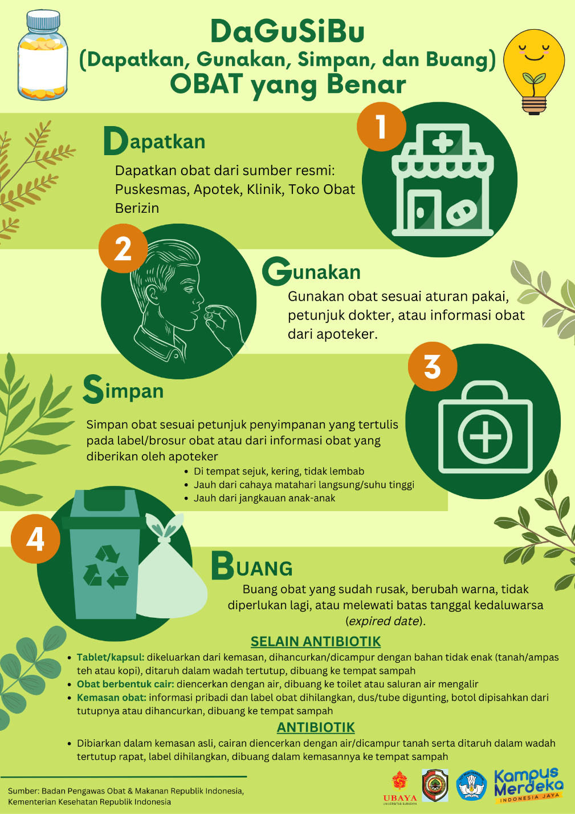
a
Supported by:
DIES NATALIS KE-59
Universitas Negeri Jakarta 1964 - 2023
Menuju universitas kelas dunia
KLJNTKJURNAL
tet�iv
\NEB Or SCIEr--..CE
Reputable Publicatio11
GENERASI PENELITI
I-CALLED
F B S . 2 0 2 3
Powered by:
CONFERENCE SYSTEM J, ,\,,\LH1 c,I
generoslpenellti.ld
International Conference on Culture, Arts, Language, Literature and Education
Faculty of Languages and Arts, Universitas Negeri Jakarta
AKADEMISI
Ad, ftlv1c"1tio� "1�tl C,v1(tv1v�
Cl Virtual via ZOOM
h ttps://icaI led-fbs-u nj. akademisi. co. id/
November 1st - 2nd, 2023
Education/training components
The educational material of PHBS consisted of 10 indicators of clean and healthy behaviours, such as: daily fruit-vegetables and physical activity, healthy toilet, clean water, and hand-washing with soap. The material is produced by The Ministry of Health of Republik Indonesia.
The training material was making antiseptic soap as a product for hand-washing.
Dagusibu’, in Indonesia, stands for ‘Dapatkan, Gunakan, Simpan, dan Buang obat dengan benar’
A principle on how to appropriately obtain, use, store, and discard medicines.
This term was coined by Indonesian Pharmacist Association as one of educational materials recommended to be delivered to Indonesian community in order to support the Family Movement of Drug Awareness
METHODS

Slide 8
a
Supported by:
DIES NATALIS KE-59
Universitas Negeri Jakarta 1964 - 2023
Menuju universitas kelas dunia
KLJNTKJURNAL
tet�iv
\NEB Or SCIEr--..CE
Reputable Publicatio11
GENERASI PENELITI
I-CALLED
F B S . 2 0 2 3
Powered by:
CONFERENCE SYSTEM J, ,\,,\LH1 c,I
generoslpenellti.ld
International Conference on Culture, Arts, Language, Literature and Education
Faculty of Languages and Arts, Universitas Negeri Jakarta
AKADEMISI
Ad, ftlv1c"1tio� "1�tl C,v1(tv1v�
Cl Virtual via ZOOM
h ttps://icaI led-fbs-u nj. akademisi. co. id/
November 1st - 2nd, 2023
Assessments
A questionnaire to gather a background knowledge on the matters was delivered to the participants
pre- and post-questions to test the knowledge were administered before and immediately after each of the education/training session
Statistical analysis was conducted using non-parametric test, p-value ≤ 0.05 was considered as statistically significant
METHODS

Slide 9
a
Supported by:
DIES NATALIS KE-59
Universitas Negeri Jakarta 1964 - 2023
Menuju universitas kelas dunia
KLJNTKJURNAL
tet�iv
\NEB Or SCIEr--..CE
Reputable Publicatio11
GENERASI PENELITI
I-CALLED
F B S . 2 0 2 3
Powered by:
CONFERENCE SYSTEM J, ,\,,\LH1 c,I
generoslpenellti.ld
International Conference on Culture, Arts, Language, Literature and Education
Faculty of Languages and Arts, Universitas Negeri Jakarta
AKADEMISI
Ad, ftlv1c"1tio� "1�tl C,v1(tv1v�
Cl Virtual via ZOOM
h ttps://icaI led-fbs-u nj. akademisi. co. id/
November 1st - 2nd, 2023
The education/training activities were conducted in July and August 2023.
Background knowledge/awareness:
The proportion of participants who were unaware of the principles of healthy lifestyles (PHBS) and DaGuSiBu were as high as 78.3% and 87.0%, respectively.
Education/training activities | Description of the results | Number of participants | Age of participants
PHBS | Rata-rata dan median skor pengetahuan setelah pelatihan lebih tinggi dibandingkan sebelum pelatihan, perbedaan ini signifikan secara statistik (rata-rata 7,05 vs 6,22; median 7 vs 6, p = 0.004). | 23 | 26 – 47 years
DaGuSiBu | Rata-rata dan median skor pengetahuan setelah pelatihan lebih tinggi dibandingkan sebelum pelatihan, perbedaan ini signifikan secara statistik (rata-rata 7,87 vs 7,17; median 8 vs 7, p = 0.009). | 23 | 26 – 47 years
We create a audiovisual product to produce a more consistent and retained knowledge of DaGuSiBu that can be accessed via the following link: https://youtu.be/wSHTlqASd1c
RESULTS

Slide 10
a
Supported by:
DIES NATALIS KE-59
Universitas Negeri Jakarta 1964 - 2023
Menuju universitas kelas dunia
KLJNTKJURNAL
tet�iv
\NEB Or SCIEr--..CE
Reputable Publicatio11
GENERASI PENELITI
I-CALLED
F B S . 2 0 2 3
Powered by:
CONFERENCE SYSTEM J, ,\,,\LH1 c,I
generoslpenellti.ld
International Conference on Culture, Arts, Language, Literature and Education
Faculty of Languages and Arts, Universitas Negeri Jakarta
AKADEMISI
Ad, ftlv1c"1tio� "1�tl C,v1(tv1v�
Cl Virtual via ZOOM
h ttps://icaI led-fbs-u nj. akademisi. co. id/
November 1st - 2nd, 2023
The program demonstrated a significant difference of knowledge on healthy lifestyle and appropriateness of medicine-related behaviours of participants in the Village of Duyung.
How this method of education/training contributes to cultural identity and consistent health-related behavior over longer time needs to be further studied.
CONCLUSIONS

Slide 11
a
Supported by:
DIES NATALIS KE-59
Universitas Negeri Jakarta 1964 - 2023
Menuju universitas kelas dunia
KLJNTKJURNAL
tet�iv
\NEB Or SCIEr--..CE
Reputable Publicatio11
GENERASI PENELITI
I-CALLED
F B S . 2 0 2 3
Powered by:
CONFERENCE SYSTEM J, ,\,,\LH1 c,I
generoslpenellti.ld
International Conference on Culture, Arts, Language, Literature and Education
Faculty of Languages and Arts, Universitas Negeri Jakarta
AKADEMISI
Ad, ftlv1c"1tio� "1�tl C,v1(tv1v�
Cl Virtual via ZOOM
h ttps://icaI led-fbs-u nj. akademisi. co. id/
November 1st - 2nd, 2023
Terima kasih

